Slide 1

Jocelyn Lau
How Can We Lower Hospital Readmission Rates?

Slide 2
Readmissions: unplanned repeat visits to the hospital
Costly and avoidable
Commonly used indicator of a hospital’s quality of care
Tied to Medicare payments
Besides patient characteristics, are there other predictors of readmission rates?

Slide 3
Predicting All-Cause Readmission Rates With Linear Regression
Outcome: # of unplanned all-cause readmissions / 100 admissions for pneumonia
Pneumonia - common and prevalent
Medicare (65+ population)
Already adjusted for age, sex, and specific clinical conditions
Notes:
used over 5 separate data sources and merged data from 12 datasets
4 census, 1 ACS, 2 healthdata.gov, 4 FY IPPS files, 1 POS
geographic:
income and education
performance
around pneumonia
around other hospital metrics
hospital characteristics
bed count (proxy for size)
labor wage index
hospital ownership
medical school affiliation

Slide 4
Predicting All-Cause Readmission Rates With Linear Regression
Outcome: # of unplanned all-cause readmissions / 100 admissions for pneumonia
Pneumonia - common and prevalent
Medicare (65+ population)
Already adjusted for age, sex, and specific clinical conditions
Predictors:
geographic/demographic
performance-related
hospital characteristics
Notes:
2,300 hospitals
used over 5 separate data sources and merged data from 12 datasets
4 census, 1 ACS, 2 healthdata.gov, 4 FY IPPS files, 1 POS
geographic:
income and education
performance
around pneumonia
around other hospital metrics
hospital characteristics
bed count (proxy for size)
labor wage index
hospital ownership
medical school affiliation

Slide 5
Predicting All-Cause Readmission Rates With Linear Regression
Outcome: # of unplanned all-cause readmissions / 100 admissions for pneumonia
Pneumonia - common and prevalent
Medicare (65+ population)
Already adjusted for age, sex, and specific clinical conditions
Predictors:
geographic/demographic
performance-related
hospital characteristics
Approach:
Linear regression: Statsmodel OLS
Cross-validation: GridSearchCV w/ Ridge and LASSO
Notes:
used over 5 separate data sources and merged data from 12 datasets
4 census, 1 ACS, 2 healthdata.gov, 4 FY IPPS files, 1 POS
geographic:
income and education
performance
around pneumonia
around other hospital metrics
hospital characteristics
bed count (proxy for size)
labor wage index
hospital ownership
medical school affiliation

Slide 6
Negative Predictors
Positive Predictors
β
Mortality rates (better than nat’l avg)
-1.8952
Timeliness of care score (better than nat’l avg)
0.5948
Mortality rates (same as nat’l avg)
-1.3484
Rural hospital
0.5318
Patient safety score (better than the nat’l avg)
Safety of care score (better than nat’l avg)
-0.9299
0.2976
Patient safety score (same as the nat’l avg)
Medicare bed count
-0.6791
0.1972
Number of pneumonia discharges
-0.0004
Income x Education
-0.0000003

Slide 7
Negative Predictors
Positive Predictors
β
Mortality rates (better than nat’l avg)
-1.8952
Rural hospital
0.5318
Income x Education
-0.0000003

Slide 8
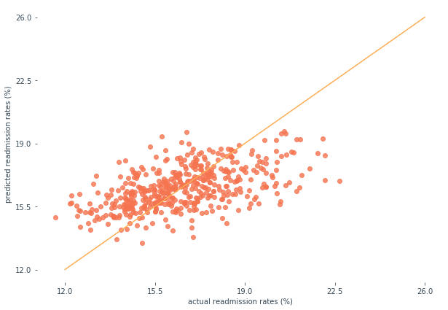
Readmission rates are hard to predict with geographic and hospital-level features
Mean Absolute Error: 1.366
Ridge MAE: 1.365 LASSO MAE: 1.363
Actual vs. Predicted Hospital Readmission Rates
Notes:
model was weakly predictive, with not too much variance but generally estimated around the mean, based on looking at this cluster around 15-16% mark
the mean absolute error was around 1.366 which represents about a 1.3% difference in percentage points - may not seem like a lot but you have to consider that the range is only around 12-20% so a 1% increase is significant
Also point out that ridge and lasso methods resulted in very small reductions in MAE but for the sake of simplicity only presented the model results here

Slide 9
Readmission rates are weakly predicted by a small subset of variables
To improve readmission rates, focus on:
Regardless of model regularization
Not explored: skill/quality of doctors/nurses
Encouraging hospitals to invest in improving mortality scores
Investing in hospitals in rural areas
Patient level, not hospital-level factors
Notes:
Weak correlation: readmission rates are not predicted significantly well by a small subset of variables
This is regardless of adjustments via model regularization
The majority is likely explained by the patient conditions themselves (which have already been adjusted for)
Not explored: quality/skill of the doctors that work at each hospital
To improve readmission rates, consider:
Focusing on hospitals in rural areas
Encouraging hospitals to invest in improving other quality metrics - these may interact with each other to lift readmission rates as well (e.g., mortality-reducing procedures may also help reduce readmissions)
Focus on patient management - if it’s not at the hospital level, go deeper

Slide 10
Thank You

Slide 11
Appendix

Slide 12
Who Cares?
Policy Makers
Hospitals
Healthcare Businesses
Inform the design of incentive and payment programs
Identify opportunities for their related products and services
Understand their performance relative to other hospitals
Improving Hospital Readmission Rates

Slide 13
Potential Predictors
Focus | Features | Data Source
Geographical/ demographic | Median income of county Education level of county Urban or Rural | 2014-2017 Census 2013-2017 American Community Survey 2017 Provider of Services file
Performance- related | Number of pneumonia discharges Performance on 5 other Medicare measures (Better, same, worse than national average) | 2014-2017 data.medicare.gov
Hospital-specific | Bed count (hospital size) Wage index (labor costs) Case mix index Hospital ownership Emergency services Medical school affiliation | 2017 Provider of Services file 2014-2016 Federal IPPS files 2014-2017 data.medicare.gov

Slide 14
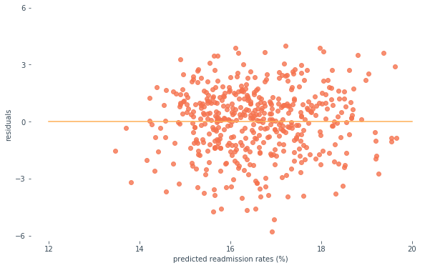
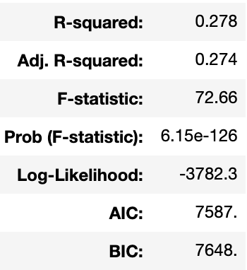
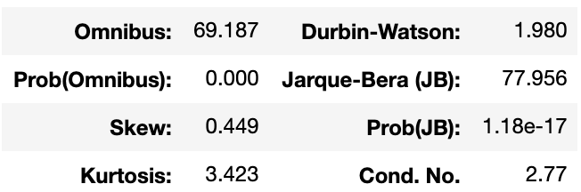
Linear Assumptions and Other Evaluation Criteria
Predicted Hospital Readmission Rates vs Residuals
Notes:
based on other model criteria, this model performs pretty well within goals
residuals were normally distributed, not heteroskedastic
difference between R-squared and adjusted R-squared is small - variance is explained
R-squared: how much of variance is explained by model
Adj R^2: penalizes for features that don’t correlate with outcome
Condition number: low
Skew: 0, Kurtosis 3: represents distribution
Durbin Watson: autocorrelation of errors - want errors to be not correlated
F statistic: standard deviations away from a test model and probability of seeing these results assuming all betas are zero
Log likelihood: probability of seeing future data like this
Omnibus: errors are normally distributed
Condition number: sensitivity of errors to inputs

Slide 15
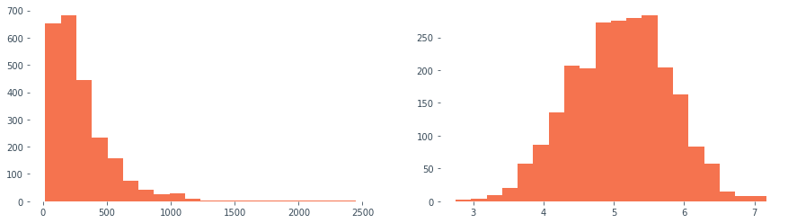
Box-cox transformation of Medicare bed count
Bed Count Transformed
(Lambda: 0.022)
Bed Count

Slide 16
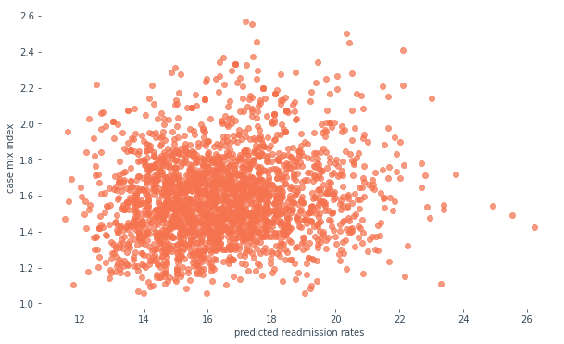
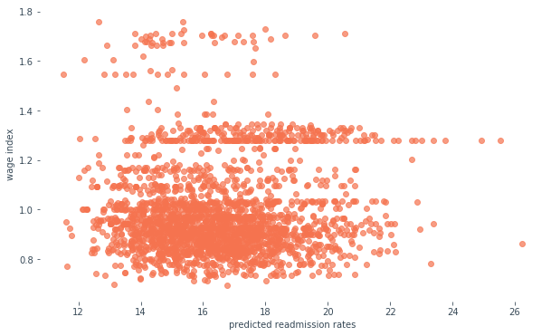
Non-significant Features
Case Mix Index
Wage Index

Slide 17
CREDITS
Presentation template by Slidesgo
Icons by Flaticon
Infographics by Freepik
Images created by Freepik
Author introduction slide photo created by Freepik
Text & Image slide photo created by Freepik.com

